Slide 1
The Design of Safety Critical Systems
ENG 514
Alan Harding

Slide 2
ENG 514 Design of Safety Critical Systems Syllabus
Safety standards relevant to the design of engineering systems.
The IEC 61508 safety lifecycle and the implementation of the various steps of the process.
Hazard identification and analysis techniques such as FMEA, HAZOP, fault trees, etc., including the use of appropriate software tools.
Qualitative and quantitative approaches. The hazard log.
The assessment of risk and establishing safety criteria.
Assigning SIL values. Random and systematic faults and the achievement of appropriate SIL values.
The interplay between safety, reliability and quality.

Slide 3
Background
RAF Engineer Officer
Harrier Sqn
Tornado Engine and Aircraft Overhaul
MoD Engineering Authority
Systems Engineer
Civil and Military Engine Control Systems
Typhoon and F35 Aircraft Fuel systems
Typhoon Export Weapon System

Slide 4
Speakers
Prof. Roger Kemp
Prof. Felix Redmill
Dr Richard Dawson
Mr David Dawson

Slide 5
ENG 514 Design of Safety Critical Systems Programme 20 –24 Jan 2014
Session | Title | Lecturer
Monday 20 Jan
09:00 - 9.30 | Safety Critical Systems: Course Introduction | AH
9..30-10.15 | Requirements | AH
10.15 -10.30 | Coffee
10.30-11.15 | Functional Decomposition | AH
11.15 - 12.45 | Tools for Designing Safe Systems | RK
12.45-13.30 | LUNCH
13:30-14.30 | Design Case Study | RK
14.30-14.45 | Coffee
14.45 -16.00 | System Redundancy | AH
16:00-17:00 | Hardware | AH

Slide 6
ENG 514 Design of Safety Critical Systems Programme 20 –24 Jan 2014
Tuesday 21 Jan
09-30- 11.00 | Some Principles of Risk for Safety | FR
11.00-11:15 | Coffee
11:15-12:15 | Safety Infrastructure | FR
12:15-13:00 | LUNCH
13:00-15-00 | Risk-based Safety and Software Management | FR
15:00-15:15 | Coffee
15:15-16.45 | The Question of Safety Integrity Levels | FR
16.45 – 17.45 | Design Case Study | RK
19:00 – 22:00 | Course dinner

Slide 7
ENG 514 Design of Safety Critical Systems Programme 20 –24 Jan 2014
Wednesday 22 Jan
09:00 - 10:30 | Management Matters and Safety | FR
10:30 – 10.45 | Coffee
10.45 – 12:15 | COTs and SOUP | FR
12:15 – 13:00 | LUNCH
13.00– 14.30 | Safety-critical Systems Standards | FR
14:30 – 14.45 | Coffee
14.45-16.15 | What Makes Software Acceptable for High-integrity Applications | FR
16.15 -17.45 | How the design Process Can Fail | RK

Slide 8
ENG 514 Design of Safety Critical Systems Programme 20 –24 Jan 2014
Thursday 23 Jan
09:00 – 10:15 | Safety Cases | AH
10:15 – 10:30 | Coffee
10:30- 12.00 | CE Marking | DD
12.00-13.00 | LUNCH
13.00-14.00 | Fault Tree Analysis and Exercise | RD
14.00 -17 00 | Course Exercise | AH
Friday 24 Jan
09:00 –10.00 | Coursework workshop | AH
10.00-10.15 | Coffee
10.15 – 11.00 | Coursework workshop | AH
11:00 – 12:00 | Wash-up | AH

Slide 9
Safety Critical Systems
Critical systems
•• Failure can result in significant economic losses, physical damage or threats to human life
Safety-critical systems
•• Failure results in loss of life, injury or damage to the environment
Mission-critical systems
•• Failure results in failure of some goal--directed activity
Business-critical systems
•• Failure results in high economic losses

Slide 10
Safety Critical Systems
Examples:
Nuclear Reactor Shutdown
Aircraft Flight Controls
Chemical Plant Pressure Relief Valves
Medical Radiographic Dose Controls
Rail Signalling
Car Braking

Slide 11
Safety Engineering
System reliability (availability) ensures that a system performs a required task or mission for (at) a specified time
System safety is concerned with ensuring that a mishap does not occur in the process.

Slide 12
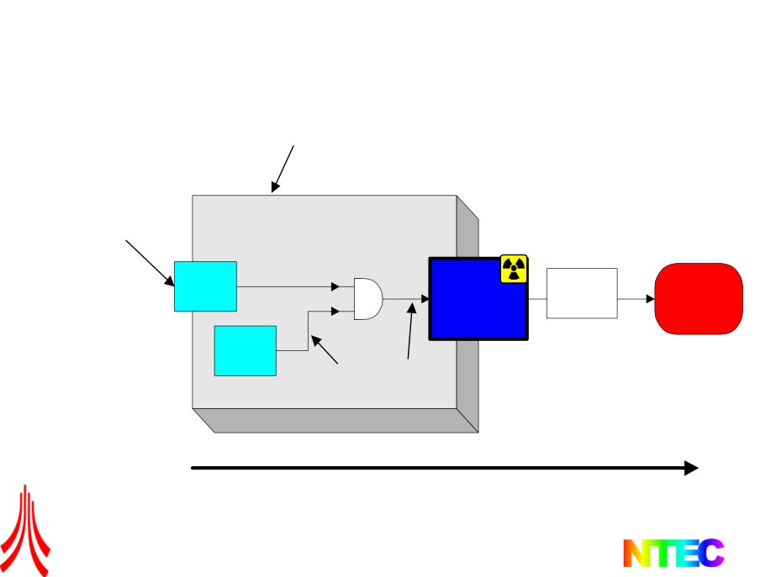
System safety terms
System
boundary
External event
System (EUC)
Fault
Env.
Causal factors Hazard
factors Accident
And
Fault
error
failure
Accident sequence
The Design of Safety Critical Systems
17

Slide 13

Key definitions
• Event - a significant happening that may originate in the system or its domain.
• Causal factors - events that contribute to hazards
• Hazard - a main event (or state of the system), over which the developer has
some control, which has the potential for human, economic or environmental
harm.
• Fault - an imperfection or deficiency in the system which may, under some
operational conditions, contribute to an error. (Faults may be safety significant
or benign)
• Error - a system state, resulting from a fault or human mistake, that is liable to
lead to a failure (Errors may be safety significant or benign)
• Failure - the inability of a system or component to fulfil its operational
requirements. Failures may be systematic or due to physical change. (Failures
may be safety significant or benign)
• Accident - an unintended event or sequence of events that causes death,
injury, environmental or material damage (harm).
• Accident sequence - The progression of events that result in an accident.
Initiating event → hazardous state → accident
The Design of Safety Critical Systems
16

Slide 14
System
Management Culture
Training
Operator
Environment
Equipment(s)

Slide 15
Some Examples
AF 447 Stall
Harrier GR1 Flap Torque Tube

Slide 16
‘Systems’ versus ‘reliability’
• The systems approach is ‘top-down’ whereas the reliability approach
is ‘bottom-up’ and hence tends to be retrospective,
• Accidents can occur without component failures,
• Safety is an emergent property of the whole system. The reliability
approach cannot identify the problems of complex interactions
between sub-systems,
• Accidents may be caused by operating conditions or time limits
outside those used for a reliability analysis,
• Reliability analysis cannot reveal systems errors such as design or
requirements errors,
• Reliability (certainly availability) may actually be in conflict with
safety. Sometimes we actually want a system to stop before further
causal events can combine to produce a worse accident.
• Reliability focuses attention on the quantitative at the expense of the
qualitative.
The Design of Safety Critical Systems
30

Slide 17
Safety vs Reliability
Reliability
Safety
High Reliability Required for System with no Fail Safe State
Fail Safe System Required

Slide 18
The value of standards
• Standards can provide
• Standards cannot
- structure to thinking and
- be used as an alternative to
process,
critical thinking,
- the ability to claim compliance,
- replace domain expertise and
knowledge,
- the basis for ‘re-use’ of safety
arguments,
- compensate for the
inadequacies of a weak safety
team
- a common approach between
different safety professionals
and sub-contractors,
- magically provide an adequate
safety case.
The Design of Safety Critical Systems
15

Slide 19
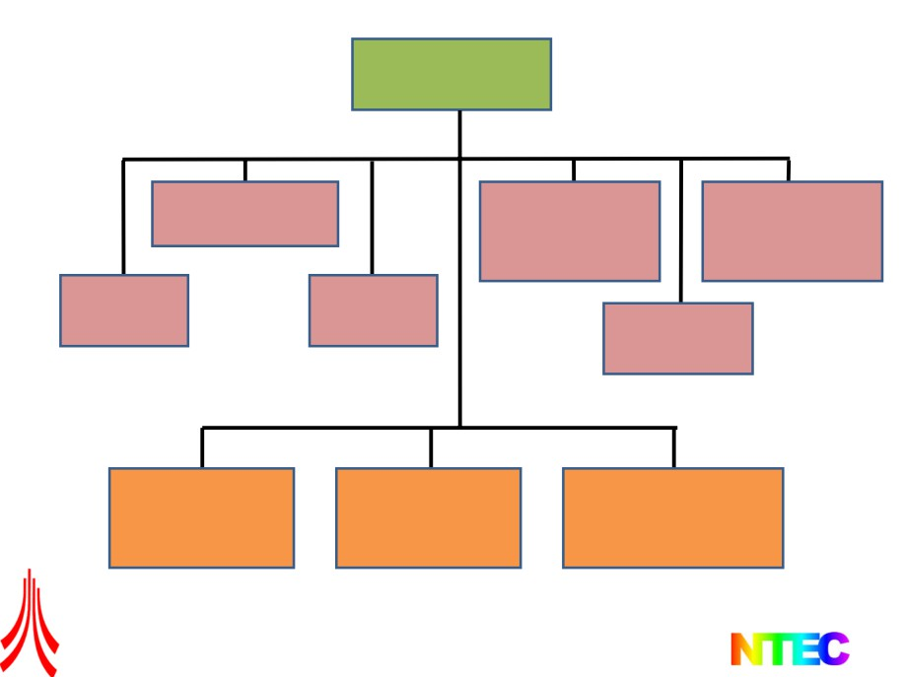
IEC 61508
Generic Standard
Standards for Industries
IEC 61511
IEC 61784-3
IEC 61326-3
Industrial Process
Digital data
Electrical
communications
equipment
IEC 62061
IEC 61513
Machinery
Nuclear
EN 50126/7/8
Railways
Standards for Manufacturers
EN ISO 13849
Low Complexity
IEC 61800
EN 50402
Gas Detectors
Adjustable Speed
Power Drive Systems
E/E Machines
IEC 61508 is an “umbrella standard” for functional safety across all industries
The Design of Safety Critical Systems
2
2

Slide 20
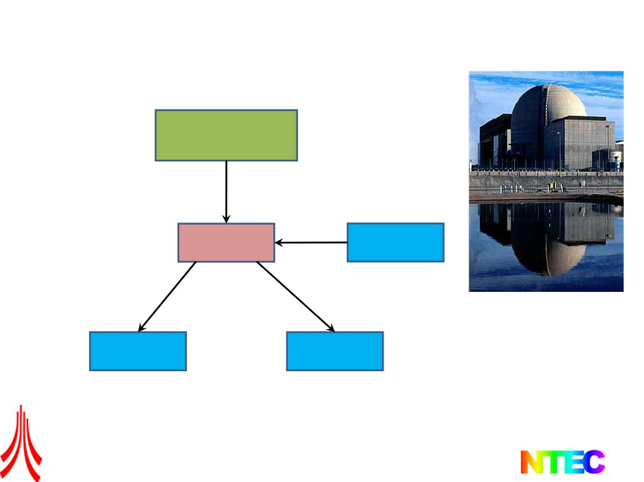
IEC Nuclear Instrumentation & Control Family
Complete life cycle
framework for safety
IEC 61508
for Programmable
Electronic Systems
Generic Standard
Application of 61508
for Nuclear Industry IEC 61513
Systems
IEC 61226
Nuclear function
categorization
IEC 60880
IEC 62138
Nuclear safety critical
Software
Nuclear non-critical
Software
The Design of Safety Critical Systems
4
4

Slide 21
IEC61513
Nuclear Power Plants - Instrumentation and Control for Systems
Important to Safety - General Requirements for Systems
• A “project” focus, whereas the parent standard IEC 61508 has
both a “project” and a “product” focus
• I&C Systems performing safety or safety-related functions
• Includes Programmable Electronic System (PES)
• System types: protection, control, monitoring or testing
• Applies to new & existing systems, however, exceptions permitted
on existing systems
The Design of Safety Critical Systems
5
5

Slide 22

IEC 62061 Machinery
• Requirements of Safety Related Electrical, Electronic
& Programmable Electronic Control Systems (SRECS)
for Machines
• Applicable to control systems used, either singly or in
combination, to carry out safety functions
• The design of complex SRECS should conform to the
relevant requirements of IEC 61508
• Does not specify requirements for the performance of
non-electrical control elements for machines
• Does not cover electrical hazards arising from the
electrical control equipment itself
• Does not cover fluid, hydraulic and pneumatic technologies
The Design of Safety Critical Systems
6
6

Slide 23
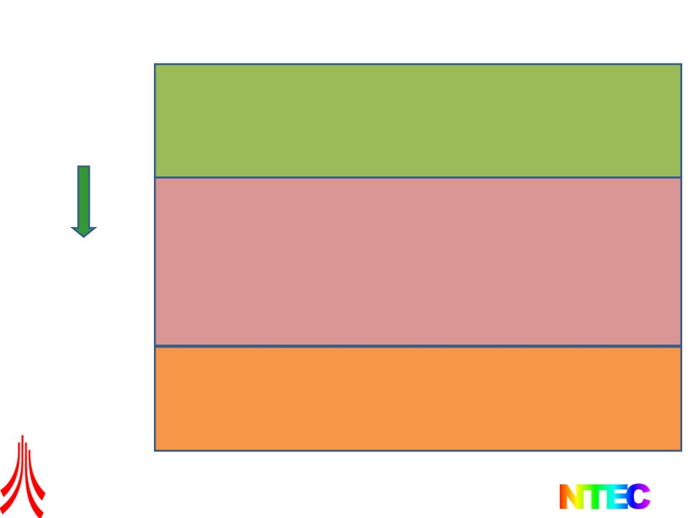
Standard Hierarchy
Functional safety of safety-related E/E/PES
Outlines the tools and formulas to calculate the probability that
safety functions will fail and then provides a system of SIL levels
to categorize these systems.
IEC 61508
Safety of machines
• As a scientific approach, it dictates how the statistical results
obtained in IEC 61508 are applied to machinery
IEC 62061
• Is too complicated
• Only rates electrical systems
Replacing EN954.1 as the general design guidelines
EN ISO 13849
Scope: Electrical, electronic and programmable electronic control
systems E/E/PES, hydraulics, pneumatics, mechanics
The Design of Safety Critical Systems
7
7

Slide 24
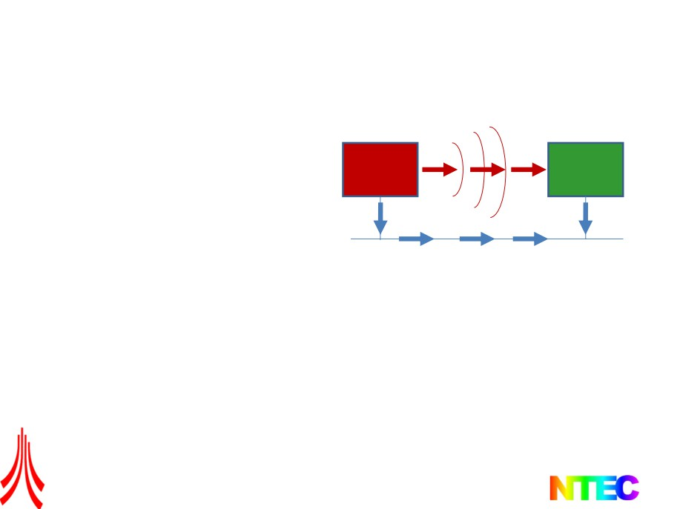
IEC 61326 Electrical equipment for measurement, control and
laboratory use - EMC requirements
Electromagnetic Coupling
Part 3-1: Immunity requirements
for safety-related systems and for
equipment intended to perform
safety-related functions - General
industrial applications
EMC Source EMC Sink
Device 1 Device 2
Part 3-2: Immunity requirements for
safety-related systems and for
Conductive Coupling
equipment intended to perform
safety-related functions - Industrial
applications with specified
electromagnetic environment
Source and sink: usually electronic hardware
devices and lightning strike etc.
Conductive Coupling: e.g., a transmission line,
wire, cable, or PCB trace
Electromagnetic Coupling: Source and sink act
as radio antennas: the source emits an
electromagnetic wave which propagates across
the open space and is received by the sink
The Design of Safety Critical Systems
9
9

Slide 25
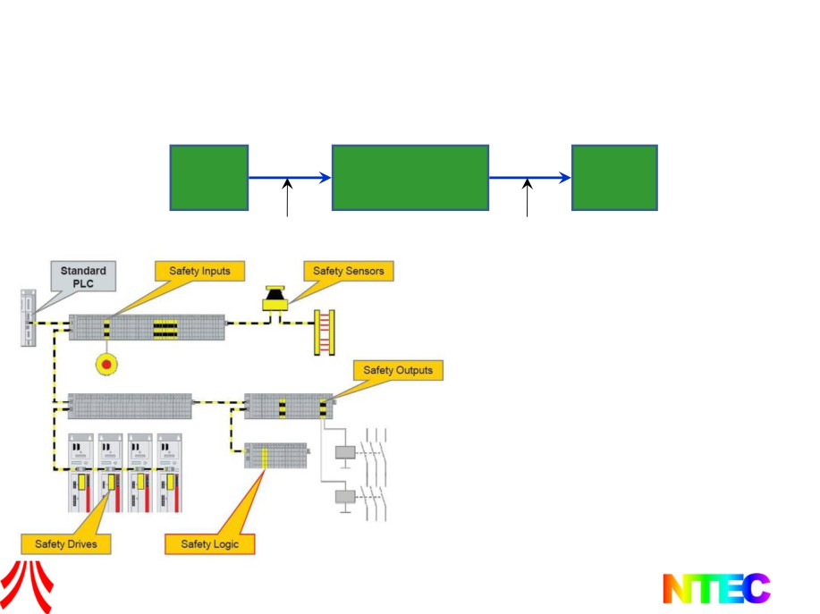
IEC 61784 Networked functional safety for process and factory automation
Part 3: Profiles for functional safe communications in industrial networks
Safety
Safety
communication
channel
communication
channel
Programmable
electronic system
Sensor
Actuator
>1%
>1%
Scope of 61784-3
• Based on “standard” fieldbus systems
• The safety communication channel should
not consume more than 1% of the
maximum PFD or PFH of the target SIL
• All safety systems shall provide a defined
safety function response time
• Constantly check communication channel
by exchanging information
PFD: Probability of failure on demand
PFH: Probability of failure per hour
10
The Design of Safety Critical Systems
10

Slide 26
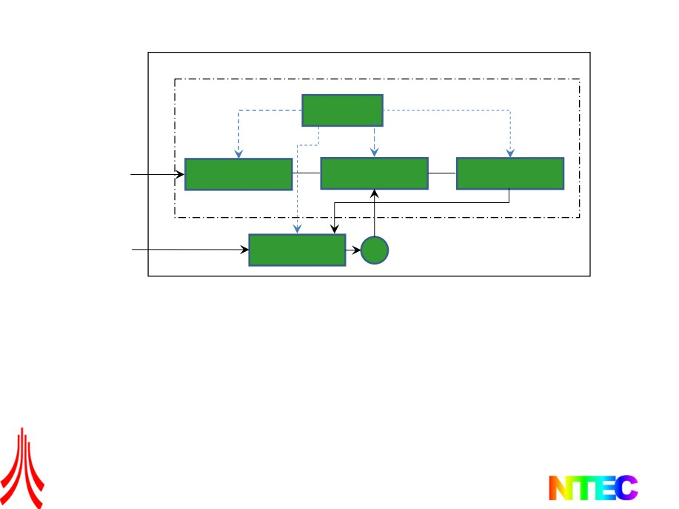
IEC 61800 A standard on functional safety of power drive system
PDS (SR): Power drive system with safety-related functions
Control section
Diagnostic
functions
External signals
Communications
Torque/Speed/
Modulation &
and control
and I/O
Position control
Protection
Power IN
Power section
M
• Functional elements considered include power conversion, drive control and motors
• DC drive systems up to 1 kV (ac, 50 or 60 Hz)
• AC drive system up to 35 kV, 50 or 60 Hz
• Validity of signals and commands is not considered
• Only up to SIL3
• Unlike 61508, it focuses on a component of a system
The Design of Safety Critical Systems
12
12

Slide 27
UK Military standards
DEF STAN 00-56 - Safety management requirements for
defence systems: Provides an almost identical approach to IEC 61508. In many ways easier to follow.
DEF STAN 00-25 - Human factors for designers of equipment
DEF STAN 00-970 - Design requirements for defence aircraft
The Design of Safety Critical Systems
13

Slide 28
Automotive standards
• MISRA - Guidelines for vehicle-based software. :
• Diagnostic and integrated vehicle systems
• Integrity
• Noise, EMC and real-time
• Software in control systems
• Software metrics
• Verification and validation
• Subcontracting of automotive software
• Human factors in software development
The Design of Safety Critical Systems
14

Slide 29
Course Exercise
Group Project: 5 Groups
Design an emergency pram runaway brake capable of retrofit to most prams
Use the design processes introduced at each stage of the course
Requirements, Specification
Functional Decomposition
HAZOP
FMECA, FTA
SIL
Safety Case

Slide 30
Course Exercise
Working through the week:
Produce a final short design report (ppt) for Friday am
Friday – 15 min presentation

Slide 31
Coursework
Group Task
Produce a design report on your teams design
Individual Task
Produce an evaluation of the team N+1 design

Slide 32
Course Examination Specimen Question
You are the safety authority for a new guided bus system that has been proposed for Lancaster. The system makes use of a cable buried in the road carrying an audio frequency current. Two coils on the front of the bus detect the field from this current and a servo system adjusts the steering to maintain the same level of signal in each coil, this ensuring the bus runs in-line with the buried cable. The accuracy of the steering system allows buses to travel faster through narrow gaps than would be possible with manual driving and thus allows two-way running on roads that would otherwise not be considered wide enough.
There will be drivers on the buses who can take over for low-speed manoeuvres in depots, for operation away from the core fitted route or if the system fails. While buses are in auto-steer mode, the drivers regulate the speed but have their hands free. To regain control of steering, a driver can operate a control lever on the desk which makes the bus behave like a conventional vehicle.
1. What techniques would you use to analyse the safety of the system described above? Please explain the approach you would adopt and the reasons for your choice. All assumptions made should be clearly stated.

